Slide 1
Investigations

Slide 2
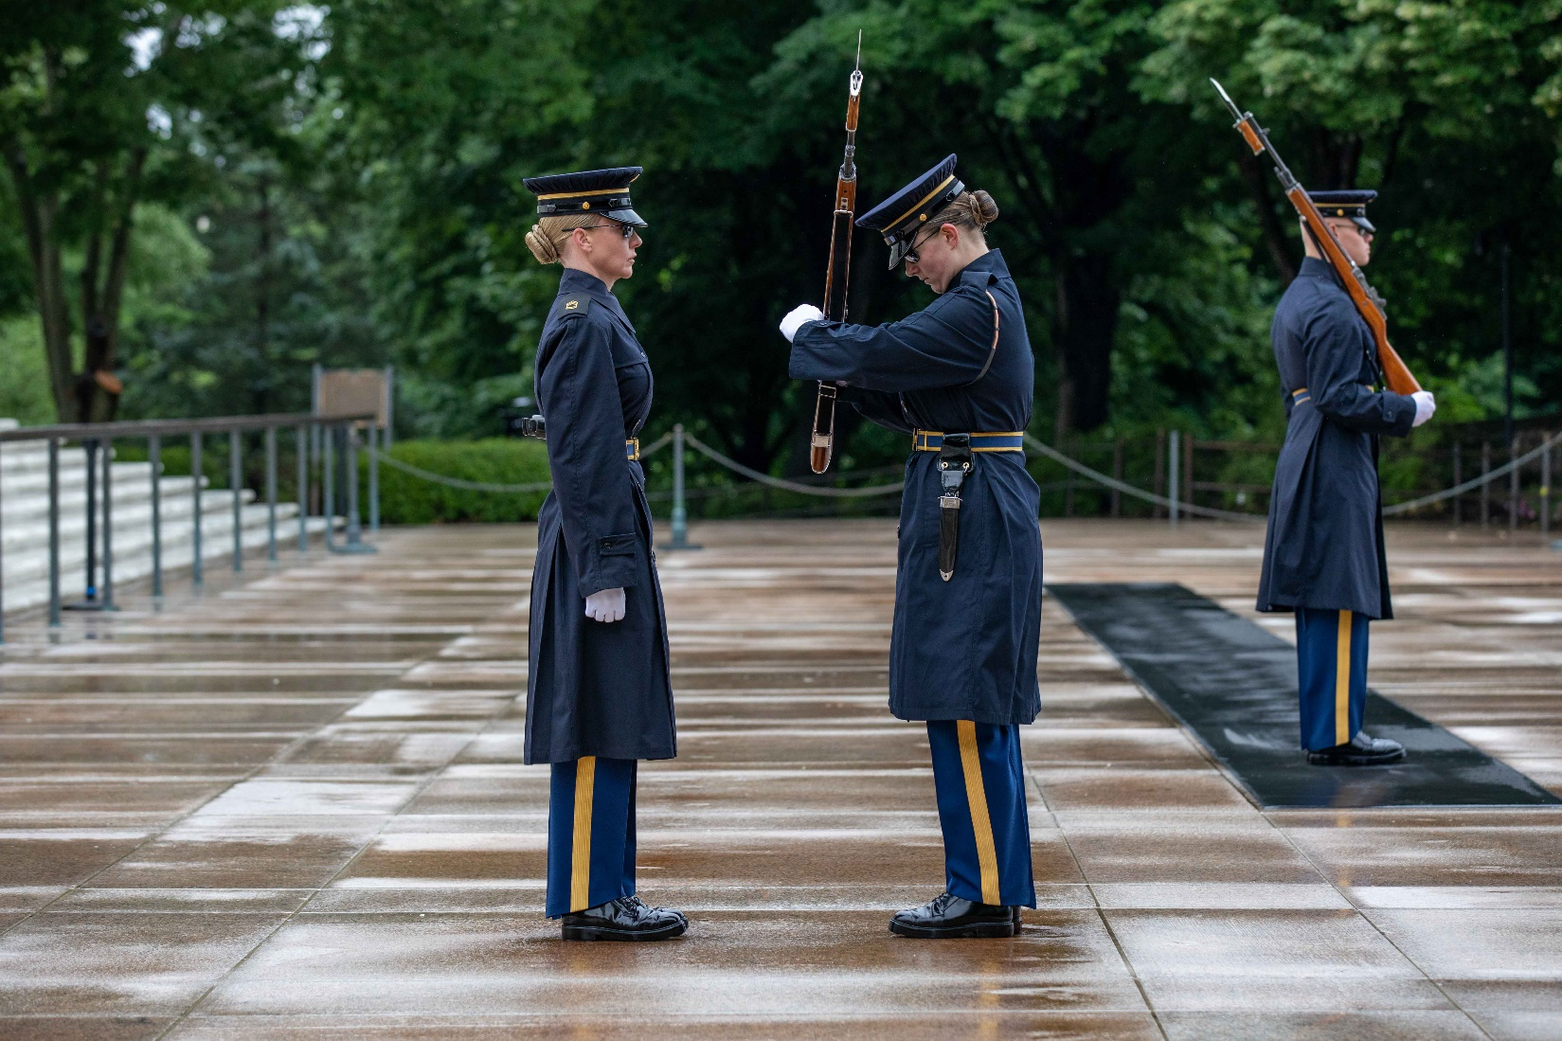
What do we see here?

Slide 3
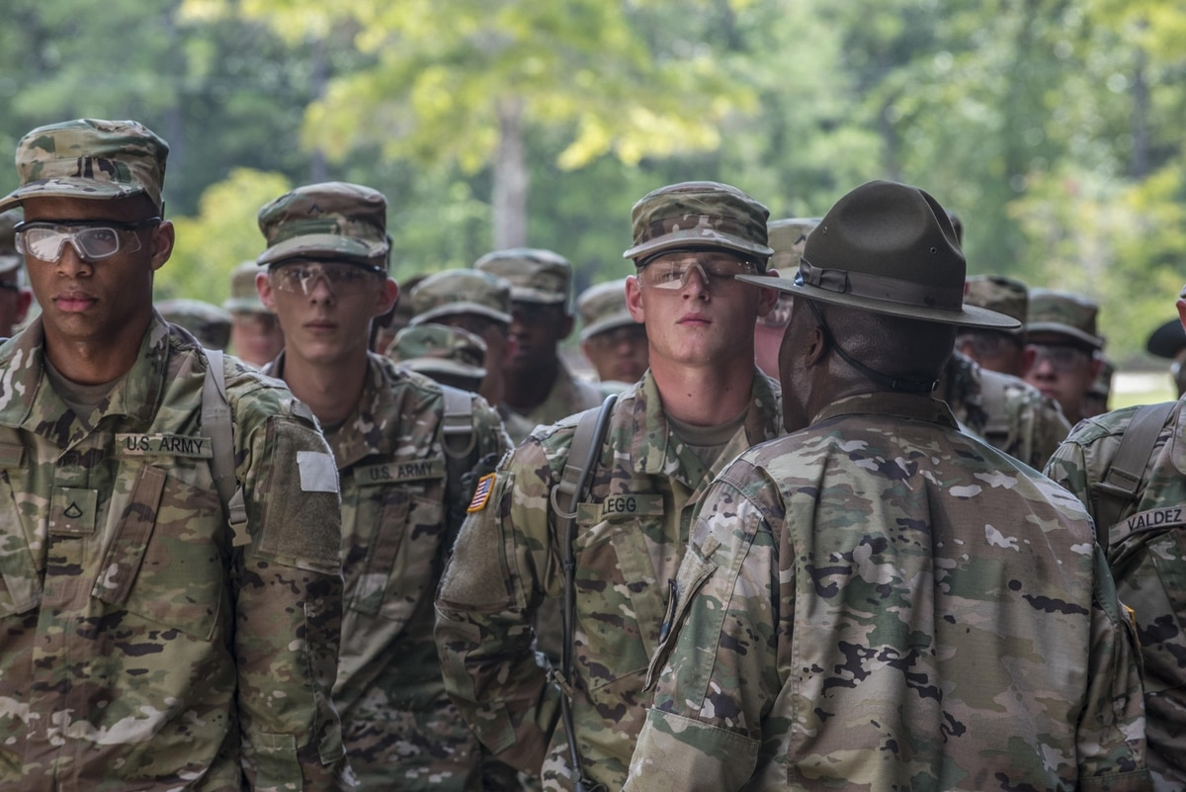
How about here?

Slide 4
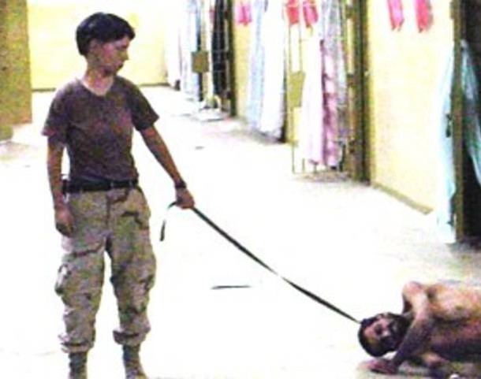
And here?

Slide 5


Slide 6
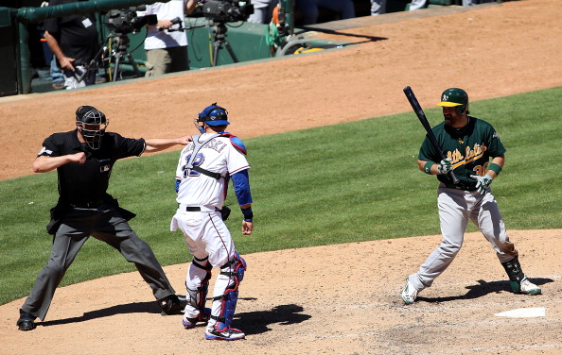

IGs are fair and impartial fact-finders…
“Through a dogged pursuit of the truth!”
“We call the balls and the strikes!”
The A&I Guide, Part Two, Section 2-6 (II-2-14)

Slide 7
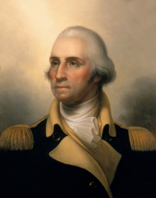
IG Investigator’s Purpose?
BLUF: Resolve Allegations of Impropriety
...using a Report of Investigation (ROI)
APPROACH:
    Unwavering commitment to standards
    Focus on Army Values
    Protect the best interests of the Army
LIMITATIONS:
    IGs work for the Directing Authority!
    One investigatory option
    DO NOT seek out allegations

Slide 8
Linked IG Functions
INSPECTIONS
TEACHING
AND
TRAINING
ASSISTANCE
INVESTIGATIONS

Slide 9
Investigations Terminal Learning Objective
Action: Resolve allegations of impropriety.
Conditions: Given Army Regulation 20-1, The Assistance and Investigations Guide, Army Regulation 600-20, DoD Directive 5500.7-R (JER), handouts, virtual classroom instruction, and allegations of impropriety.
Standard: Apply the seven-step Inspector General Action Process (IGAP) to resolve an allegation of impropriety, culminating in a Report of Investigation (ROI) that accurately substantiates or does not substantiate the allegation. In addition, describe special situations with regard to Inspector General Investigations.

Slide 10

References
  AR 20-1, IG Activities and Procedures Chapters 3 and 7, Appendix D, and the Glossary
  The Assistance and Investigations Guide Part Two & Part Three (and some of Part One)
  Advance Sheets & Class CD
  Please have these resources available every class!
AR 20-1 / Other Source Information Reference; The A&I Guide, Source Information Reference

Slide 11
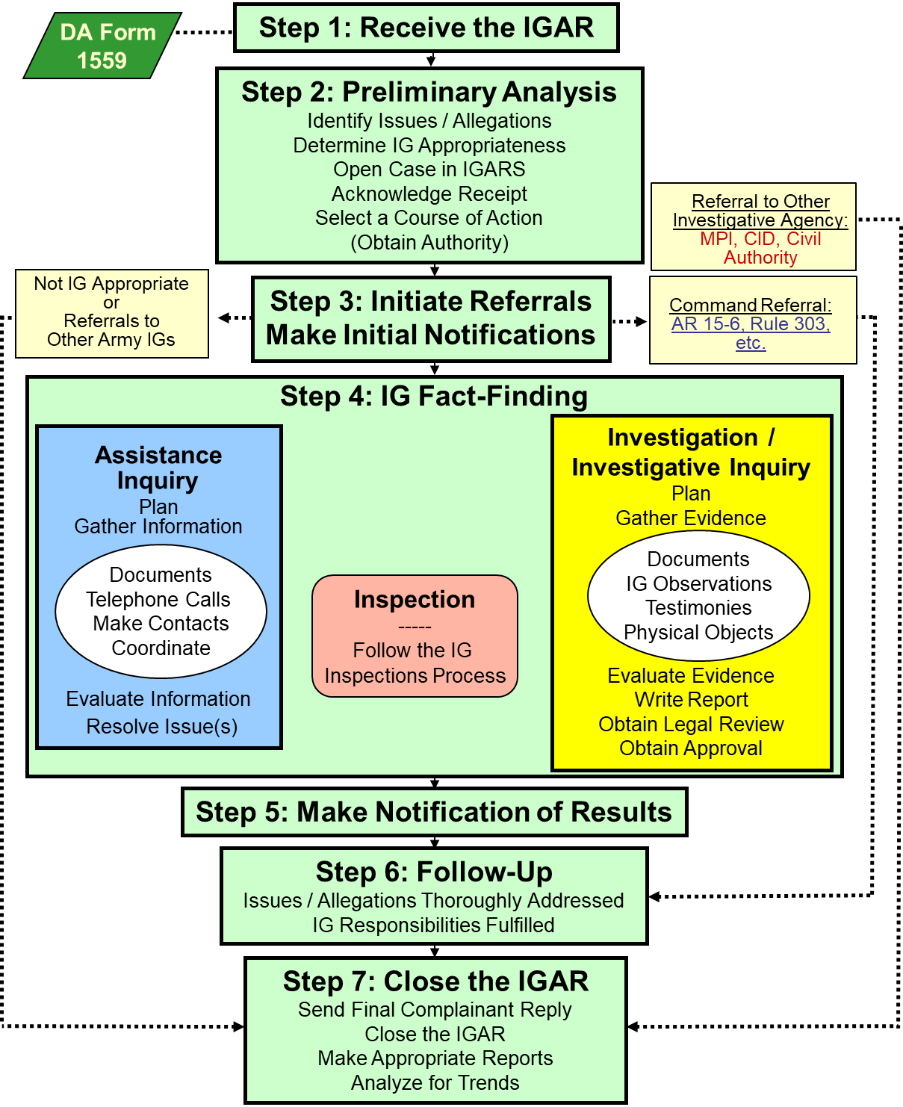
Investigations
Overview
Introduction / DEFINITIONS
IGAP Step 1
IGAP Step 2 / 3
Gather the Facts Step 4
Analyze the Evidence
Write the report: ROI / ROII
Make Notifications Step 5
Closure & Release Step 6 / 7
Review / Quiz / HW / Final

Slide 12
Enabling Learning
Objectives
Advance Sheets pages 14 - 16
ELOs
Knowledge-based ELOs:
1. Describe a person’s role and status in an IG Investigation / Investigative Inquiry.
2. Describe an individual’s rights or non-rights given that person’s role and status.
3. Describe a fact and the levels of evidence used in the Investigations function.
4. Describe the IG Standard of proof.

Slide 13
Enabling Learning
Objectives
ELOs
Knowledge-based ELOs (cont.):
5. Describe the parts of an allegation.
Describe the actions an IG should take upon receiving an allegation against a senior official.
Describe an IG Investigation and an IG Investigative Inquiry and the differences between them.

Slide 14
Enabling Learning
Objectives
ELOs
Knowledge-based ELOs (cont.):
Describe the procedures for referring allegations of impropriety to the command.
9. Describe how an IG plans an Investigative Inquiry or Investigation.
10. Describe a request for IG information and the proper actions taken by the IG.

Slide 15
Enabling Learning
Objectives
ELOs
Application-based ELOs:
11. Identify the allegations and issues in a complaint.
12. Determine if an allegation received by the IG is appropriate for IG action.
13. Explain which IG method – Investigative Inquiry or Investigation – is preferable for a particular case.

Slide 16
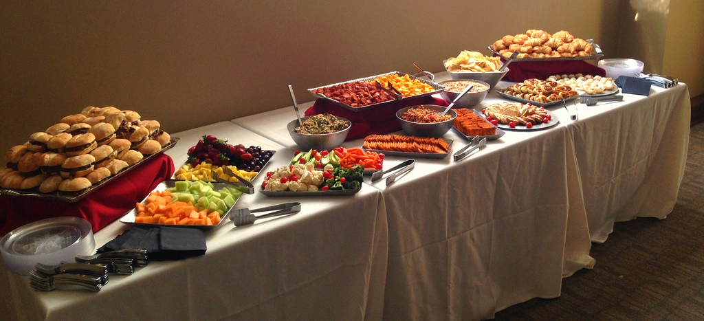
Enabling Learning
Objectives
ELOs
Application-based ELOs (cont.):
14. Demonstrate evidence-gathering activities by reviewing documents; analyzing data; and interviewing witnesses, subjects, or suspects.
15. Complete a Report of Investigation (ROI).

Slide 17
Person's Role and Status
DEFINITIONS
ELO
1
Role: Witness, Subject, Suspect
Status: Military, DA Civilian, Contract Civilian,
or Civilian-Civilian
Complainant: Anonymous, Injured Party, Third Party
Subject / Suspect: Unit? Status? At the times in question
Commander / Supervisor
AR 20-1, Paragraph 7-1g; The A&I Guide, Part Two, Section 1-3 (II-1-10)

Slide 18
Roles
DEFINITIONS
Witness:
  Someone who we believe has some knowledge to support or to refute an allegation (may be a subject-matter expert (SME))
Subject:
  Someone against whom a non-criminal allegation is made
Suspect:
  Someone against whom a criminal * allegation is made
  *Violations of law (UCMJ & USC) are criminal offenses.
AR 20-1, Paragraph 7-1g; The A&I Guide, Part Two, Section 1-3 (II-1-10)

Slide 19

Status
DEFINITIONS
Who is required to cooperate & when?
Military?
  Army Active Component?
  Army Reserve?
  Army National Guard?
Department of the Army Civilians?
Contractors?
Other DoD Military / Civilian Personnel?
Civilians not employed by the DoD?
  (Civilian / Civilians)
Always
When in a duty status
When in a duty status
Always
It depends on the contract
Chain of command
Never
The A&I Guide, Part Two, Section 1-6 (II-1-18)

Slide 20
Summary
ELO 1. Describe a person’s role and status in an IG Investigation / Investigative Inquiry.
  Witness, Subject, Suspect
  DA Civilian Employee
  Civilian-Civilian

Slide 21


Rights and Non-Rights
ELO
2
Inspector General
Investigation / Investigative Inquiry
ADMINISTRATIVE DUE
PROCESS
WITNESS
SUBJECT
SUSPECT
AR 20-1, Paragraph 7-1g;
The A&I Guide, Part Two, Sections 1-4 (II-1-12), and 1-5 (II-1-16)

Slide 22
Rights
Based on Role
DEFINITIONS
WITNESS
1. Consult with Counsel (but...)
2. Confidentiality (but...)
3. Review Own Testimony (in...)
4. Avoid Self Incrimination (Stop!)
5. Have a Union Rep present (if...)
SUBJECT
Witness rights...and!
6. Know and Comment on Allegations
7. Know and Comment on
Unfavorable Information
8. Remain Silent
SUSPECT
Subject and Witness rights...AND!
Have Article 31 Rights:
9. Have Counsel Present
AR 20-1, Paragraph 7-1g; The A&I Guide, Part Two, Section 1-4 (II-1-12)

Slide 23
Non-Rights
DEFINITIONS
Know the identity of witnesses
Be present during questioning of others
Question others
Review evidence
Audio / video record testimony [AR 20-1, 7-1.b(4)(f)]
Take / Remove written notes from IG interview*
Have a friend present during questioning*
* IG / CIG has some discretion
IG confidentiality
AR 20-1, Paragraphs 3-1 and 3-2; The A&I Guide, Part Two, Section 1-5 (II-1-16)

Slide 24

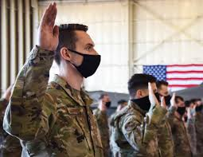

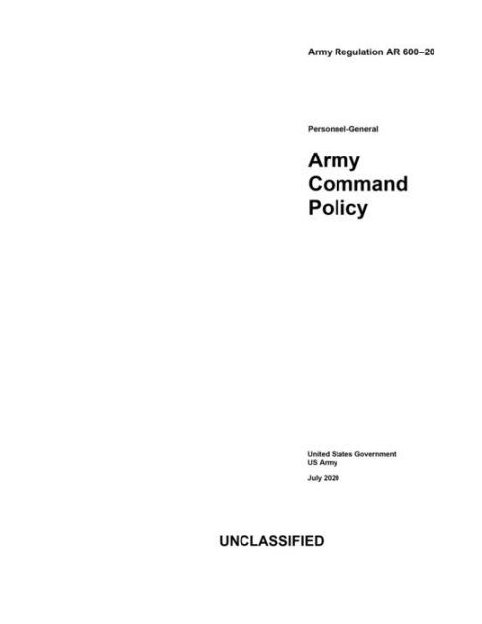
Categories of Evidence
DEFINITIONS
Recorded Under oath Documents
High
Testimony - Recorded under oath, transcribed or summarized! (sworn statement)
Physical - Objects; not common
Standard - Regulation, SOP, etc
Documents
Statements - Written
IG Personal Observation - Stay Away!
Low
The A&I Guide, Part Two, Section 1-8 (II-1-23)

Slide 25
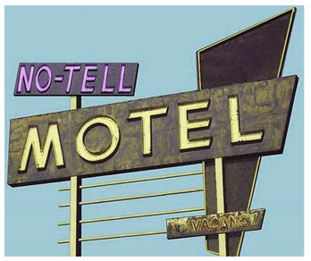

Levels of Evidence
DEFINITIONS
ELO
3
Direct - First-hand knowledge
Circumstantial - Tends to prove or disprove an issue by inference
Hearsay - What one individual says another person said
Opinion - A person’s belief or judgment
High
Low
(D – C – H – O)
Evidence is also characterized by its quality, detail, and credibility. Always conduct a credibility assessment.
The A&I Guide, Part Two, Section 1-9 (II-1-27)

Slide 26


Fact
DEFINITIONS
ELO
3
Events that are known to have happened
Things that are known to be true
Can be a combination of testimonies, documents or physical evidence
Must independently agree on a single point
The A&I Guide, Part Two, Section 1-10 (II-1-28)

Slide 27
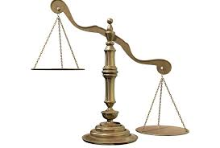
IG Standard of Proof
DEFINITION
ELO
4
Preponderance of credible evidence
  That evidence which has superiority of weight
  >50%
  "More likely than not, it probably occurred"
Only two conclusions:
Substantiated
Not Substantiated
"S"
"N"
AR 20-1, Paragraph 7-2; The A&I Guide, Part Two, Section 1-11 (II-1-29)

Slide 28

4-Part Allegation
DEFINITION
ELO
5
Who
  Must be an individual; name
Improperly
  The word “improperly” shows wrongdoing – may be implied
Did (or failed to do)
In Violation of a Standard
  A standard is law, regulation, or policy
AR 20-1, Glossary; The A&I Guide, Part Two, Section 2-2 (II-2-3)

Slide 29
Summary
ELO 2. Describe an individual’s rights or non-rights given that person’s role and status.
  Witness, Subject, Suspect
ELO 3. Describe a fact and the levels of evidence used in the Investigations function.
ELO 4. Describe the IG Standard of proof.
ELO 5. Describe the parts of an allegation.

Slide 30
The Seven-Step IGAP
Step One
Step 1 Receive the IGAR
Anyone
IGARs come from the in crowd:
  Walk-in
  Call-in
  Write-in
  E-mail-in
  FAX-in
  gym / party / PX / bathroom / mall
  Bottom line – who can give an IGAR?
AR 20-1, paragraph 6-1d (1) and 7-1b(1)
The A&I Guide, Part Two, Sect. 1-14 (II-1-33)

Slide 31
Not Local IG Appropriate Senior Official Allegations
ELO
6
Allegations against
  COL(P), GO, or USMA Professor
  Senior Executive Service (SES) civilian
Report to DAIG Investigations Division within 2 working days
DO NOT conduct ANY IG Preliminary Analysis
Verify with Investigations Division before entering in IGARS as an Information IGAR
  DO NOT name the senior official
  DO NOT complete a DA Form 1559
AR 20-1, Paragraph 7-1l, Appendix D-1; The A&I Guide, Part One, Section 3-2-1 (I-3-24)

Slide 32
Complainant Disclosure
IGs will refer all command-appropriate allegations to the chain of command for investigation along with all provided documentary evidence in un-redacted form.
IG confidentiality applies, but limited upon referral to the command
Annotate consent / non-consent on DA Form 1559 to release of personal information and / or documents
  Anonymous, Consent, Partial Consent, No Consent
Upload all documents in IGARS but DO NOT stamp or mark documents referred to the command with standard IG classification marking
AR 20-1, Paragraphs 1-13e, 3-4g, and 6-1d; The A&I Guide, Part Two, Section 3-1-1 (II-3-2)

Slide 33
Step Two: IG Preliminary Analysis
ELO
11
IGPA
Step 2 Preliminary Analysis
Identify Issues / Allegations
Determine IG Appropriateness
Open Case in IGARS
Acknowledge Receipt
Select a Course of Action
(Obtain Authority)
Let's look at a complaint!
AR 20-1, Paragraph 6-1d and 7-1b
The A&I Guide, Part Two, Section 2-3 (II-2-7)

Slide 34
‘Typical’ Complaint
Our director, COL Brown, is a real JERK. He has a clique of cronies that get all the good deals. The rest of us don’t get anything. He also ordered new office furniture for himself and his SECRETARY. That is a real waste since we are laying off good workers. I also heard that he accepted a unit gift at his change of command that cost over $300. He boasts that he is “IN TIGHT” with the General and that is why he can do whatever he wants to do. If you check, you can verify these things with Ms. ROSE, Mr. CALVIN, and Mr. HOBBS. They know about HIM.
A CONCERNED EMPLOYEE
Notes:
.

Slide 35
Here’s a written complaint left on your door!
DEAR INSPECTOR GENERAL,
COL Brown, the Director, is having an affair with the secretary.
Concerned and Jealous
P.S. And he often doesn’t even show up for work!

Slide 36
Poorly Phrased Allegations
What do you think?
COL Robert E. Brown acted improperly in that he committed adultery with Ms. Smith on June 25th, 2014, in NJ, in violation of the UCMJ.
COL Robert E. Brown wasn't at work in violation of AR 600-20, paragraph 2-17.
Who, Improperly, Did, IVO

Slide 37
How About These?
COL Robert E. Brown committed adultery in violation of Article 134 (Extramarital sexual conduct), UCMJ.
COL Robert E. Brown was improperly absent from his place of duty in violation of Article 86, UCMJ.

Slide 38

Where to Find Standards
(use the standard at the time in question)
United States Code (USC): www.law.cornell.edu/uscode/
Code of Federal Regulations (CFR): https://www.ecfr.gov/
DoD Directives: https://www.esd.whs.mil/DD/
Army Regulations: https://armypubs.army.mil
National Guard Regulations: https://www.ngbpmc.ng.mil/ngr/
Army Reserve Regulations: www.usar.army.mil/Publications/
Camp, post, or station local regulations, policies, and SOPs

Slide 39

Elements of Proof
Words Have Meaning!
Read what the standard says
– "don't read into it"
Conjunctions count
  And,
  Or, Nor, For
  But, Yet, So
Ask your SJA for interpretation and advice

Slide 40
Elements of Proof
Manual for Courts Martial (2019 Edition) Article 134, Extramarital sexual conduct
Article 134, (Extramarital sexual conduct) UCMJ, states, “Text of statute. See paragraph 91.”
Elements.
(1) That the accused wrongfully engaged in extramarital conduct as described in subparagraph c. (2) with a certain person;
(2) That, at the time, the accused knew that the accused or the other person was married to someone else; and
(3) That, under the circumstances, the conduct of the accused was either: (i) to the prejudice of good order and discipline in the armed forces; (ii) was of a nature to bring discredit upon the armed forces; or (iii) to the prejudice of good order and discipline in the armed forces and of a nature to bring discredit upon the armed forces.

Slide 41
Elements of Proof
Manual for Courts Martial (2019 Edition) Article 86 Absence without leave
(1 of 2)
Article 86, UCMJ, states that: “Any member of the armed forces who, without authority-- (1) fails to go to his appointed place of duty at the time prescribed; (2) goes from that place; or (3) absents himself or remains absent from his unit, organization, or place of duty at which he is required to be at the time prescribed; shall be punished as a court martial may direct.”
Elements:
(1) Failure to go to appointed place of duty;
(2) Going from appointed place of duty;
(3) Absence from unit, organization, or place of duty; (4) Abandoning watch or guard;
(5) Absence from unit, organizations, or place of duty with intent to avoid maneuvers or field exercises.

Slide 42
Elements of Proof
Manual for Courts Martial (2019 Edition) Article 86 Absence without leave
(2 of 2)
Elements (cont’d)
(1) Failure to go to appointed place of duty.
(a) That a certain authority appointed a certain time and place of duty for the accused; and
(b) That the accused knew of that time and place; and
(c) That the accused, without authority, failed to go to the appointed place of duty at the time prescribed.

Slide 43

Consultation with the SJA
Not required, but it is a really good idea
Helps refine allegations
Helps select proper standards
Helps identify Elements of Proof
SJA interprets regulations and law and advises the commander on the investigative COAs
The IG investigates allegations of impropriety

Slide 44
Summary
ELO 6. Describe the actions an IG should take upon receiving an allegation against a senior official.
ELO 11. Identify the allegations and issues in a complaint.
  Parts of a properly worded allegation
  Role of the SJA

Slide 45
Step Two: IG Preliminary Analysis
IGPA
Step 2 Preliminary Analysis
Identify Issues / Allegations
Determine IG Appropriateness
Open Case in IGARS
Acknowledge Receipt
Select a Course of Action
(Obtain Authority)
AR 20-1, Paragraph 6-1d and 7-1b
The A&I Guide, Part Two, Section 2-5 (II-2-10)

Slide 46
Reasons why the IG Won't investigate
ELO
12
If the allegation involves serious criminal misconduct, then the IG will not normally investigate! These are outside the IG purview.
If substantiation and adverse action appear certain
Commanders must also consider these factors:
  Established means for regulatory redress already exists
  The Commander's preference is to select another means to investigate the matter
  The IG recommended another non-specific form of investigation
If the allegation is Not Local IG Appropriate
The A&I Guide, Part Two, Section 2-5 (II-2-10)
U.S. Army Inspector General School
Notes:
46

Slide 47






Not Local IG Appropriate
Allegations against Professionals
ELO
12
Any Army lawyer (military or civilian) refer to DAIG’s Legal Advisor (AR 20-1, paragraph 7-1i (4)-(5))
IGs refer to next higher IG (AR 20-1, paragraph 7-1j)
Medical, CID Agents, Recruiters, Chaplains (The A&I Guide, Part One, Section 3-2-3)
AR 20-1, Paragraph 7-1i
The A&I Guide, Part One, Section 3-2-3, and Part Two, Section 2-5 (II-2-10)

Slide 48
Not Local IG Appropriate
Allegations against Members of SAPs & SAs
ELO
12
Allegations against
  Members of special-access programs (SAP)
  Members of sensitive activities (SA)
Report to DAIG Intelligence Oversight Division within 2 working days
AR 20-1, Paragraph 1-4b(5)(e); The A&I Guide, Part One, Section 3-2-2 (I-3-26)

Slide 49
Step Two: IG Preliminary Analysis
IGPA
Step 2 Preliminary Analysis
Identify Issues / Allegations
Determine IG Appropriateness
Open Case in IGARS
Acknowledge Receipt
Select a Course of Action
(Obtain Authority)
AR 20-1, Paragraph 6-1d and 7-1b
The A&I Guide, Part One, Section 2-3-3 (I-2-30)

Slide 50
Reporting Requirements
For Allegations Against:
Inspectors General: Input allegations into the IGARS database and report to the next higher-echelon IG for appropriate action within two working days* AR 20-1, paragraph 7-1j (1), and Appendix D-1
COL and below: Input allegations into the IGARS database within two working days*
  Command or Local IG can inquire / investigate
  AR 20-1, paragraph 7-1k (1), and Appendix D-1;
* IGARS AUTOMATICALLY sends SAIG-AC and SAIG-IN a notice.
AR 20-1, Paragraph 7-1j, and Appendix D-1; The A&I Guide, Part Two, Section 2-4 (II-2-8)

Slide 51
Step Two: IG Preliminary Analysis
IGPA
Step 2 Preliminary Analysis
Identify Issues / Allegations
Determine IG Appropriateness
Open Case in IGARS
Acknowledge Receipt
Select a Course of Action
(Obtain Authority)
AR 20-1, Paragraph 6-1d and 7-1b
The A&I Guide, Part Two, Section 2-6 (II-2-12)

Slide 52
Inspector General
Preliminary Analysis
(Step 2 – Course of Action)
During preliminary analysis, we must select an IG course of action to best solve the puzzle.
Which IG course of action do we choose?
  Referral to another form of investigation?
  IG Investigation / IG Investigative Inquiry, or
  the Commander’s guidance can help you determine which course of action to select.
“It Depends”/ CCIRs

Slide 53
STEP 2: Conduct IGPA
Select a Course of Action
Inspection
Assistance Inquiry
Referral (command, other agency, or IG)
Investigation / Investigative Inquiry
The A&I Guide, Part Two, Section 3-1-1 (II-3-2)

Slide 54
Referring Allegations to the Command (1 OF 2)
ELO
8
IGs will formally refer ALL command-appropriate allegations to the command unless explicitly directed otherwise by the Directing Authority
The command will execute all notifications to Subject(s), Suspect(s), and Commander / supervisor
IGs will review the resulting command product to verify the command addressed the nature of the allegation referred by the IG; DO NOT evaluate the quality of the command product
If the command product properly addressed the allegation(s), close the case in IGARS as “Command Referred”
AR 20-1, Paragraph 7-1a and 7-1i; The A&I Guide, Part Two, Section 3-1-1 (II-3-2) and (II-3-8)

Slide 55
Referring Allegations to the Command (2 of 2)
ELO
8
If the command product DID NOT answer the allegations:
  1. Address with the responsible Commander to resolve
  If still not in agreement…
  2. Address with next higher Commander
  If still not in agreement…
  3. Consult with the SJA and present to the Directing Authority
  If still not in agreement…
  4. Present to next higher IG office, annotate action in case notes, and close the case in IGARS as “Command Referred”
AR 20-1, Paragraph 7-1i; The A&I Guide, Part Two, Section 3-1-1 (II-3-6)

Slide 56


What the IG SHOULD Investigate
ELO
12
If the allegation is IG appropriate, then the IG should investigate when...
  It is the Directing Authority’s preference
  AND
  These factors are present:
    Lack of factual information surrounding the allegation
    Sensitivity of allegations; IGs are trained investigators
    Confidentiality is important; identities must be protected
    Protect reputations AND preserve unit cohesion
The A&I Guide, Part Two, Section 2-6 (II-2-13)
Notes:
56

Slide 57
STEP 2: Conduct IGPA
Select a Course of Action
ELO
12
Inspection
Assistance Inquiry
Referral (Command, Other Agency, or IG)
Investigation / Investigative Inquiry
Note: Once the DA initiates an IG Investigation, the DA cannot terminate it, even if substantiation appears likely and adverse action may be appropriate. The IG must complete the investigation and provide the results to the DA.
AR 20-1, Paragraph 7-1d(8); The A&I Guide, Part Two, Section 2-6 (II-2-12)

Slide 58
STEP 2: Conduct IGPA
Select Course of Action
ELO
7
INVESTIGATIVE INQUIRY
IG
Resolve Allegations of a less serious nature
Informal fact-finding process (Directing Authority verbal or written directive)
Written ROII
Less testimony, more statements
INVESTIGATION
IG
Resolve Allegations of a more serious nature
Formal fact-finding process (Directing Authority Written Directive)
Written ROI
More testimony, less statements
Both the ROI & ROII require the same measure of proof and due diligence by the IG.
AR 20-1, Paragraph 7-1a and 7-2
The A&I Guide, Part Two, Sections 1-2 (II-1-6), 2-7 (II-2-16), and 2-8 (II-2-17)

Slide 59
Investigation or
Investigative Inquiry?
ELO
13
Factors to consider favoring an Investigation:
  The allegation is serious and could result in adverse action
  High degree of documentation is important / required
  The potential for harm to a Soldier (or Soldiers) exists
  Adversely affects the image of the Army
  May have great impact on the command
  The allegation will likely have media interest
  The Commander directs the IG to investigate
The A&I Guide, Part Two, Sections 2-8 (II-2-17)

Slide 60
Summary
ELO 7. Describe an IG Investigation and an IG Investigative Inquiry and the differences between them.
ELO 8. Describe the procedures for referring allegations of impropriety to the command.
ELO 12. Determine if an allegation received by the IG is appropriate for IG action.
ELO 13. Explain which IG method – Investigative Inquiry or Investigation – is preferable for a particular case.

Slide 61
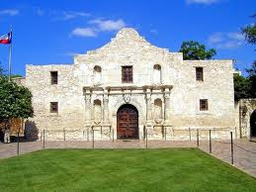
ALAMO Case Study
Step One
Step 1 Receive the IGAR
PE #1 - LTC Bowie
(Class CD - Day 9- PE 1)
AR 20-1, Paragraph 6-1d (1) and 7-1b(1) The A&I Guide, Part Two, Sect. 1-14 (II-1-33)

Slide 62
ALAMO Case Study
Step 2: IGPA
Step 2 Preliminary Analysis
Identify Issues / Allegations
Determine IG Appropriateness
Open Case in IGARS
Acknowledge Receipt
Select a Course of Action
(Obtain Authority)
What are the issues and allegations?
Who is the subject / suspect?
What’s the next step?
AR 20-1, Paragraph 6-1d and 7-1b The A&I Guide, Part Two, Section 2-3 (II-2-7)

Slide 63

ALAMO Case Study
Step 2: IGPA
Step 2 Preliminary Analysis
Identify Issues / Allegations
Determine IG Appropriateness
Open Case in IGARS
Acknowledge Receipt
Select a Course of Action
(Obtain Authority)
Let’s talk to the
complainant…
PE #2
Do we have clarification on the issues and allegations?
AR 20-1, Paragraph 6-1d and 7-1b The A&I Guide, Part Two, Section 2-3 (II-2-7)

Slide 64
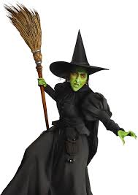
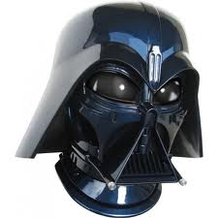
ALAMO Case Study
Issues / Allegations
Family Readiness Group
Spouse misbehavior ???
Improper Relief
“Toxic" Leadership” *
  Abusive, vindictive, harassing
  Targeting, threatening
  "Reign of Terror“
Dr. Betty Santa Anna
COL Santa Anna
* ADP 6-22, 31 July 2019, Paragraph 8-46 (p. 8-7) currently defines “Counterproductive Leadership”

Slide 65
ALAMO Case Study
Step 2: IGPA
Step 2 Preliminary Analysis
Identify Issues / Allegations
Determine IG Appropriateness
Open Case in IGARS
Acknowledge Receipt
Select a Course of Action
(Obtain Authority)
What standards apply?
Who can help determine and refine standard selection?
Let’s talk to the SJA… PE #3
AR 20-1, Paragraph 6-1d and 7-1b The A&I Guide, Part Two, Section 2-3 (II-2-7)

Slide 66
4-Part Allegation
#1 COL Santa Anna improperly mistreated his subordinates in violation of Army Regulation (AR) 600-20, paragraph 4-19.
#2 COL Santa Anna improperly relieved a subordinate commander in violation of
AR 600-20, paragraph 2-17.
xxxxxxxxxxxx
Which version of AR 600-20 was in effect at the time?
The A&I Guide, Part Two, Sect. 1-14 (II-1-33)

Slide 67
Elements of Proof
AR 600-20 (6 November 2014), paragraph 4-19,
Treatment of persons
  The Army is a values based organization where everyone is expected to do what is right by treating all persons as they should be treated – with dignity and respect. Hazing, bullying, and other behaviors that undermine dignity and respect are fundamentally in opposition to our values and are prohibited. This paragraph is punitive.
  What are the elements of proof of this standard?

Slide 68
Elements of Proof
AR 600-20, paragraph 2-17
Relief for Cause
a. When a higher ranking commander loses confidence in a subordinate commander’s ability to command due to misconduct, poor judgment, the subordinate’s inability to complete assigned duties, or for other similar reasons, the higher ranking commander has the authority to relieve the subordinate commander.
  1. Must counsel unless inappropriate or impractical under the circumstances.
  2. Commander may temporarily suspend, but must get final written approval from the first general officer in the chain of command.
  3. Action is temporary until the first general officer in the chain of command submits his or her written approval.
"BUT"
b. If relieved as a result of an AR 15-6 investigation, then
  1. Referral and comment procedure of that regulation must be followed.
  2. Relieved officer may be temporarily suspended pending completion of the procedural safeguards contained in AR 15-6.
  3. Action to relieve before completion of the procedural safeguards of
  AR 15-6 is a temporary suspension.

Slide 69
ALAMO Case Study
Step 2: IGPA
Step 2 Preliminary Analysis
Identify Issues / Allegations
Determine IG Appropriateness
Open Case in IGARS
Acknowledge Receipt
Select a Course of Action
(Obtain Authority)
Is this IG Appropriate?
Why or why not?
What are the IG’s reporting requirements?
AR 20-1, Paragraph 6-1d and 7-1b The A&I Guide, Part Two, Section 2-5 (II-2-10)

Slide 70
ALAMO Case Study
Step 2: IGPA
Step 2 Preliminary Analysis
Identify Issues / Allegations
Determine IG Appropriateness
Open Case in IGARS
Acknowledge Receipt
Select a Course of Action
(Obtain Authority)
Select a Course of Action
When should the IG investigate?
Investigative Inquiry or Investigation?
Acknowledge Receipt…. PE #4
AR 20-1, Paragraph 6-1d and 7-1b The A&I Guide, Part Two, Section 2-6 (II-2-12)

Slide 71
Step Two: IG Preliminary Analysis
IGPA
Step 2 Preliminary Analysis
Identify Issues / Allegations
Determine IG Appropriateness
Open Case in IGARS
Acknowledge Receipt
Select a Course of Action
(Obtain Authority)
AR 20-1, Paragraph 7-1b (2); The A&I Guide, Part Two, Section 2-9 (II-2-19)

Slide 72
Obtain Authority –
Investigative Inquiry
ELO
7
(Step 2)
Requires Directing Authority to initiate
  Verbal guidance to CIG
  Written
Based on Commander’s guidance (CCIRs)
Results in an ROII
AR 20-1, Paragraph 7-1a; The A&I Guide, Part Two, Section 2-9 (II-2-19)

Slide 73

Obtain Authority –
Investigation
ELO
7
(Step 2)
Requires a written Directive from the directing authority (CG / TAG / TIG)
The IG leading the investigation normally prepares the Action Memorandum and the Directive
The CIG normally briefs the directing authority to request signature on the Directive
Results in an ROI
AR 20-1, Paragraph 7-1b (2); The A&I Guide, Part Two, Section 2-9 (II-2-19)

Slide 74
Action Memorandum
(Step 2)
Gives background information
States the allegation(s)
Summarizes the entire case
Provides the scope and the
limits of the investigation
Includes SJA opinion
Recommends approval to proceed
Signed by the Command IG
This is pre-decisional: NOT RELEASABLE
FOIA
EXEMPT

Slide 75
Directive
(Step 2)
Authorizes the investigation or inquiry
General description of the allegation
  Names are not included to protect confidentiality
  Directive IS RELEASABLE and presented to all those necessary to show your authority
Signed by the Directing Authority
subject to
FOIA

Slide 76

Action Memo + Directive
(Step 2)
Ensures a clear, mutual understanding
between the IG and the directing authority
concerning who and what to investigate
The IG’s "order" from the Directing Authority

Slide 77
ALAMO Case Study
Step 2: IGPA
Step 2 Preliminary Analysis
Identify Issues / Allegations
Determine IG Appropriateness
Open Case in IGARS
Acknowledge Receipt
Select a Course of Action
(Obtain Authority)
Who signs the Action Memo?
Who sees the Action Memo?
Who sees the Directive?
PE #5
AR 20-1, Paragraph 7-1b (2); The A&I Guide, Part Two, Section 2-9 (II-2-19)

Slide 78
Summary
ELO 7. Describe an IG Investigation and an IG Investigative Inquiry and the differences between them.
  Action Memorandum
  Directive

Slide 79
Step Three: Referrals and
Make Initial Notifications
Step 3 Initiate Referrals
Make Initial Notifications
AR 20-1, paragraph 6-1d (3) and 7-1b(3);
The A&I Guide, Part Two, Chapter 3

Slide 80
Initiate Referrals
(Step 3)
If a non-IG investigation is determined, the IG will refer the allegations to the command or agency for action.
Initial notifications to commander(s) / supervisor(s) / subject(s) / suspect(s) are the responsibility of the investigating command / agency
  What can the IG tell another Army investigator?
  What can the IG tell a non-Army investigator?
  AR 20-1, Paragraphs 3-5 & 7-1; The A&I Guide, Part Two, Section 3-1-1 (II-3-2)

Slide 81
Requests for IG Information
ELO
10
ELO
9
Review own testimony: (before the report is complete)
  Witness, subject / suspect: In the IG office, but they don’t get to keep a copy
  AR 20-1, Paragraph 7-1b; The A&I Guide, Part Two, Section 1-4
Department of the Army Investigator: (before or after the report is complete)
  Allegation list
  Documents not given in confidence to the IG
  Witness list with brief synopsis of relevant testimony
AR 20-1, Paragraph 3-4g; The A&I Guide, Part Three, Section 1-6
FOIA: Unofficial business (only after the report is approved)
  AR 20-1, Paragraph 3-7; The A&I Guide, Part Three, Section 1-5

Slide 82
Release of IG Records
Release Authority (All IG Records): TIG (or designated representative)
Official Use 1) Inspection Reports (Directing Authority)
2) ROI / ROII (Directing Authority)
3) "BIG 3" (DA Investigator): Nature of allegations, readily available documents, witness list with a synopsis of their testimony
4) Complainant provided documents with release consent
Adverse Action NOTHING: Only TIG can approve based on request properly submitted to DAIG
Non-DA Official NOTHING: FOIA request must be submitted to website or
DAIG's Records-Release Office within 2 days (only after the case is closed) Unofficial Use
BEWARE of careless handling of IG documents (maintain control). Don't give unauthorized info to complainant, witness, subject / suspect, commanders or senior leaders (COS or other GOs) that are not your Directing Authority.

Slide 83
Step Three: Referrals and
Make Initial Notifications
Step 3 Initiate Referrals
Make Initial Notifications
AR 20-1, Paragraph 6-1d (3) and 7-1b(3);
The A&I Guide, Part Two, Chapter 3

Slide 84
Make Initial Notifications
(Step 3)
Verbally notify appropriate commanders and / or supervisors of the investigation (inquiry) and inform them of the nature of the allegations
Verbally notify the subjects or suspects of the investigation (inquiry) and inform them of the nature of the allegations, or the specific allegations
Record notifications in IGARS and in the ROI / ROII
  AR 20-1, Paragraph 7-1b; The A&I Guide, Part Two, Section 3-2 (II-3-16)

Slide 85
ALAMO Case Study
Step 3: Make Notifications
Step 3 Initiate Referrals
Make Initial Notifications
Who is COL Santa Anna’s commander / supervisor?
Who do we notify first and why?
Let’s notify COL Santa Anna…
PE#6
Get through the script!
AR 20-1, Paragraph 6-1d (3) and 7-1b(3); The A&I Guide, Part Two, Chapter 3 (II-3–20)

Slide 86
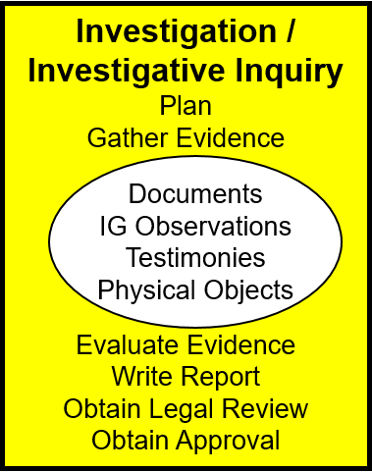
Step Four:
IG Fact Finding
AR 20-1, Paragraph 7-1b(4);
The A&I Guide, Part Two, Chapter 4

Slide 87

Written Investigative Plan
DEFINITION
ELO
9
An IG Investigation / Investigative Inquiry requires a written investigative plan (working document / pre-decisional)
A written investigative plan must include 3 things:
  Witness list including complainant, SMEs, and subject / suspect
  Itinerary / schedule: time, location, and sequence of Interviews
  Interrogatories / Interview Questions
AR 20-1, Paragraph 7-1b(4); The A&I Guide, Part Two, Section 4-2 (II-4-3)

Slide 88
Interview Questions
What are the standards and elements of proof?
Determine the key facts necessary to
address the elements of proof.
Who
What
When
Where
Why
How
How many / how much
WHAT IS A FACT?
W
5
H
2

Slide 89
Interview Questions
(cont'd)
Weak interview:
Do you and Ms Smith have a romantic relationship?
Do others perceive your relationship with Ms Smith as
inappropriate?
Are you always performing your duties as required?
Stronger interview:
Describe the nature of your relationship with Ms Smith.
Describe when and where you must perform your duties
away from your office and / or after normal duty hours.
What additional information can you provide that will
help the IG resolve this matter?

Slide 90
Interview Questions
(cont'd)
It’s been a while.
When did this intimate
relationship begin?
A
We have an intimate and
romantic relationship.
After my divorce.
Q
Describe the nature of
your relationship with
Ms. Smith.
I don 't know. Ask them.
A
What about your relationship
might others perceive as
improper?
A
Q
It is both professional and personal.
We spend a lot of time together.
Be prepared to adjust and to change the focus of your questioning based on the answers.
The A&I Guide, Part Two, Appendix B (II-B-4)

Slide 91
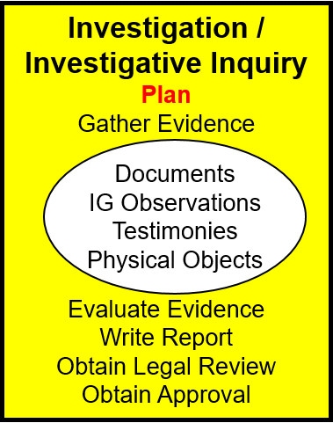
ALAMO Case Study
Step 4: Plan
PE #7 What’s missing?
Expect to change your plan!
AR 20-1, Paragraph 7-1b(4); The A&I Guide, Part Two, Section 4-2 (II-4-3)

Slide 92
Summary
ELO 9. Describe how an IG plans an Investigative Inquiry or Investigation
  Written Investigative Plan
ELO 10. Describe a request for IG information and the proper actions taken by the IG.
  Review of Testimony
  Follow on DA Investigator

Slide 93
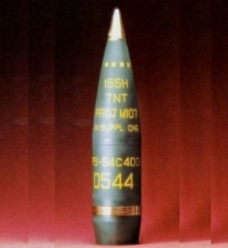
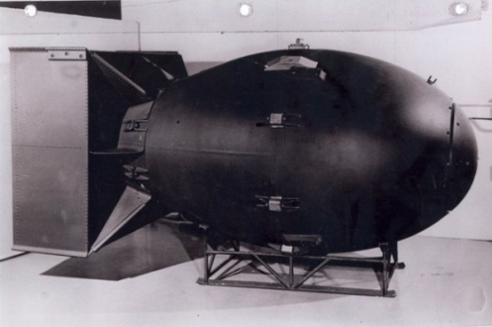
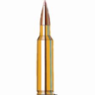
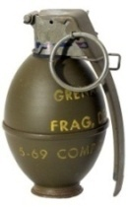
Execute Your Plan
(Step 4)
Collect documents throughout
IGs usually take testimony under oath
How many witnesses do we interview?
  MINIMUM NUMBER NECESSARY to substantiate or refute the allegation(s) – you decide, IG!
  Thorough, but don’t go for overkill!
        The A&I Guide, Part Two, Section 4-2 (II-4-3)

Slide 94


Gather Evidence
(Step 4)
ELO
14
Create an Evidence Matrix ....
Collect documents ...........
Collect physical evidence ..........................
Conduct interviews:
  Complainant ..................
  Experts ....................................
  Witnesses (How Many?)....................
  Subjects / Suspects ............................

Slide 95
Investigation Plan – OTR 16-0021
Evidence Matrix
 | Mistreatment | Improper Relief | Other/Due Outs
LTC Bowie | BN Commanders confronted Santa Anna Mrs. Santa Anna threatened to have him relieved and COL Santa Anna ratified the threat "my wife speaks for me" Has not received his OER COL Santa Anna removed BN S-3 just before deployment Mrs. Santa Anna abusive, COL Santa Anna did not intervene | Believes he was relieved in theater because CDR did not like wife COL Santa Anna claimed relief was for poor judgment COL Santa Anna threatened Bowie; get wife under control or be relieved (page 6) BG Klink warned LTC Bowie Santa Anna "out to get him" Relieved March 6 | Interview LTC Ewing, LTC Crockett, LTC Houston, MAJ Rose, and Ursula Bowie Consult with SJA, re: FRG coordinator cooperation requirements
E-mail | "If you cannot get your wife under control, then I will find someone who can. Signed Gunfighter Six." | "If you cannot get your wife under control, then I will find someone who can. Signed Gunfighter Six."
MAJ Rose
LTC Crockett
LTC Ewing
Betty Santa Anna
COL Santa Anna
organize
your data
early & often
FOR OFFICIAL USE ONLY. DISSEMINATION IS PROHIBITED
EXCEPT AS AUTHORIZED BY AR 20-1.
TIMELINE (according to LTC Bowie)
Santa Anna
command
Disagreement
and Email
Deployed OEF
Ordered to Report
LTC Bowie
Relieved
Complaint
Letter
LTC Bowie
Interview
OCT
DEC
MAR
5 MAR
6 MAR
14 APR
17 APR

Slide 96
Collect Documents
(Step 4)
Command Product Use in an IG Inquiry / IG Investigation:
Can be used as a piece of evidence to resolve allegations of impropriety
DO NOT conduct a due-process review
U.S. Army Inspector General School
Notes:
96

Slide 97
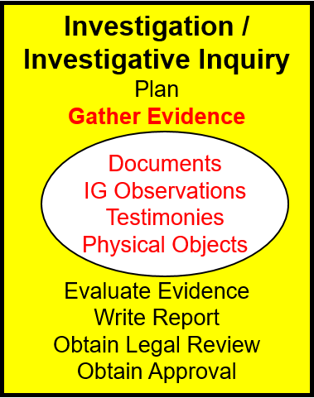
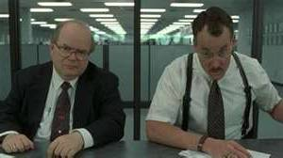
ALAMO Case Study
Step 4: Gather Evidence
PE #8
Let’s search the web and other documents
Let’s interview LTC Ewing and LTC Crocket
Update the Matrix and Timeline!
AR 20-1, Paragraph 7-1b(4); The A&I Guide, Part Two, Section 4-3 (II-4-12)

Slide 98
ALAMO Case Study
Step 4: Gather Evidence
PE #9
Let’s interview MAJ Rose
What did we get?
Update the Matrix and Timeline!
AR 20-1, Paragraph 7-1b(4); The A&I Guide, Part Two, Section 4-3 (II-4-12)

Slide 99
ALAMO Case Study
Step 4: Gather Evidence
PE #10
Let’s interview LTC Houston
What did we get?
Update the Matrix and Timeline!
AR 20-1, Paragraph 7-1b(4); The A&I Guide, Part Two, Section 4-3 (II-4-12)

Slide 100

Four-Part Interview
Pre-brief (not recorded – never off the record)
Read-in (recorded)
Questioning (recorded)
Read-out (recorded)
Prepare using Appendix A: Interview Prep Book
The A&I Guide, Part Two, Section 4-8 (II-4-25), and Appendix A (II-A-1)

Slide 101
Interview: Part 1
Establish
rapport
1. Pre-brief (explain in plain English)
  The IG interview process and IG confidentiality
  The IG's Role
  Privacy Act
  Header Sheet
  Rights Warning
  Swearing / Affirming Oaths
  Filling in documents and forms
Lay down the
ground rules
Observe baseline behavior of the witness’s speech and mannerisms.
(as an IG, not as an "Interrogator")
The A&I Guide, Part Two, Section 4-8 (II-4-26)

Slide 102
Interview Parts 2, 3 + 4
2. Read-in (recorded): Verbatim
3. Questioning (recorded): Rehearse this one the most! Follow interrogatory BUT listen to the witness's answers and adjust accordingly.
You may stop the recorder...
but you are never off the record.
4. Read-out (recorded): Verbatim
The A&I Guide, Part Two, Section 4-8 (II-4-27), and Appendix A (II-A-12)

Slide 103
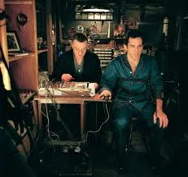
Successful Interviews
Preparation & Rehearsal
IG Attitude & Demeanor
IG ability to:
Put the witness at ease
Maintain impartiality
Adapt to the unexpected
LISTEN! LISTEN! LISTEN!
OBSERVE!
No Surprises - No Trickery
IG must ask the questions necessary to uncover credible evidence that address elements of proof!
The A&I Guide, Part Two, Sections 4-4 through 4-10, and Appendix B

Slide 104
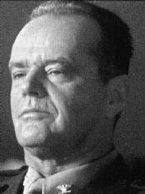
Interviews
AVOID:
  Being defensive / aggressive
  Interrupting the witness
  Asking:
    Yes or No questions
    Leading questions
    Irrelevant questions
    DO NOT:
  Lose control of interview
  Lose your temper
  Give advice or counsel
  Be intimidated

Slide 105
Interviews:
What NOT To Do!
{Show news report video about a tape recorded IG interview... gone wrong!}

Slide 106
Summary
ELO 14. Demonstrate evidence-gathering activities by reviewing documents; analyzing data; and interviewing witnesses, subjects, or suspects.
  Four Parts of an IG interview
  Appendix A and B
  Interrogatory Development
  Rehearsals

Slide 107

Telephonic Witness Interview
Four-Part Interview process
Pre-brief
Read-in
  - Which script?
Interrogatory questions
Read-out
It’s now time to interview Betty Santa Anna! – PE #11

Slide 108
Suspect Interview
DA 3881 Required
"Liar's Paragraph"
Lawyers
PE #12
  AR 20-1, Paragraph 7-1b(4)(d);
  The A&I Guide, Part Two, Section 4-6 (II-4-19), and Part Two, Appendix A (II-A-28)

Slide 109
Summary
ELO 14. Demonstrate evidence-gathering activities by reviewing documents; analyzing data; and interviewing witnesses, subjects, or suspects.
  Evidence Matrix information
  Determining witnesses
  Interview order
  DA Form 3881
Now prepare for the Suspect 4-Part Interview!

Slide 110
Suspect Interview
Four-Part Interview process
Pre-brief
Read-in
  - Which script?
Questions
Read-out
PE #13
(same sequence - different script / different documents)

Slide 111
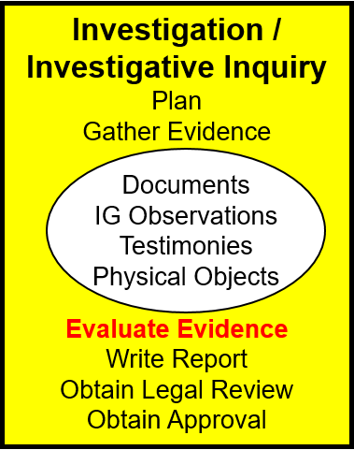
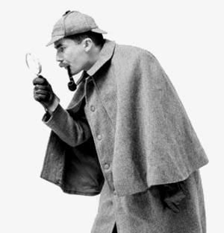
ALAMO Case Study
Step 4: Evaluate Evidence
Transcripts, Documents, Anything Else?
Now update your Evidence Matrix, witness list, and your interview questions!!!
AR 20-1, Paragraph 6-1d and 7-1b The A&I Guide, Part Two, Section 4-1 (II-4-2)

Slide 112

Evaluate the Evidence
(Step 4)
Analyze for accuracy, veracity, and relevance
Check for inconsistencies and corroboration
Summarize redundancies
Determine and correct voids
Draw clear and supported
conclusions
Use your best judgment
Complete your Evidence Matrix
The A&I Guide, Part Two, Sections 1-11 (II-1-29), and 4-1 (II-4-2)

Slide 113
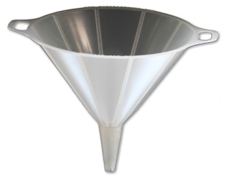
#2: COL Santa Anna improperly relieved a subordinate commander in violation of Army Regulation (AR) 600-20, paragraph 2-17. (Also list the elements of proof here)
Force-Field Diagram
(Step 4)
Prepare a diagram for each allegation
documents
testimony
physical evidence
‘S’ubstantiate
statements
EVIDENCE
‘N’ot Substantiate
Elements
of proof
'filter'
(D)
(C)
(H)
(O)
The A&I Guide, Part Two, Sections 1-11 (II-1-30); 4-12 (II-4-42); and Figure II-4-4 (II-4-43)

Slide 114
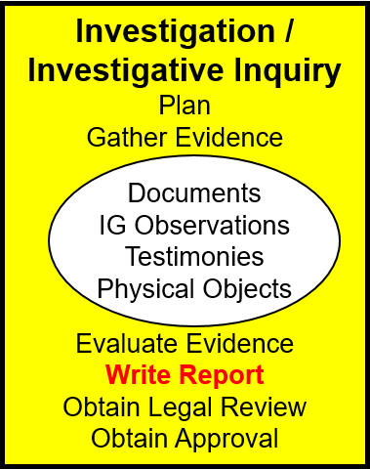
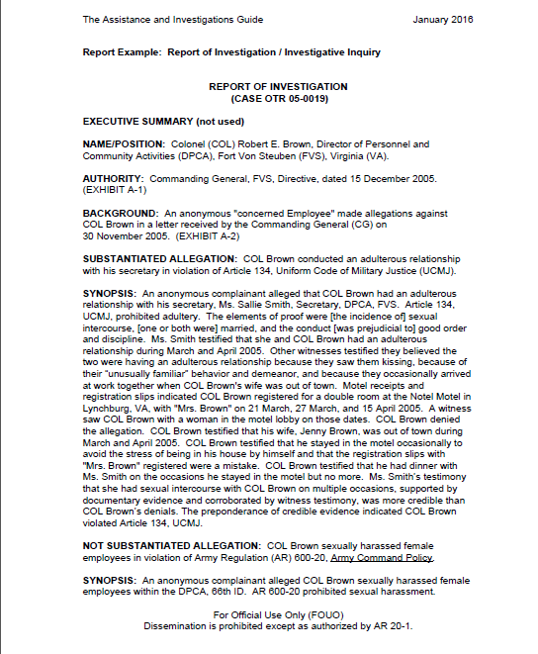
ALAMO Case Study
Step 4: Write Report
PE #14
Graded homework exercise
AR 20-1, Paragraph 7-1b(4)
        The A&I Guide, Part Two, Sections 4-13, (II-4-44 to 150, Appendix D)

Slide 115
Prepare to Write the ROI
ELO
15
Resolve Allegations of Impropriety using a Report of Investigation (ROI)
Review ALL of the evidence
Review ALL of the elements of proof
Complete and check your Evidence Matrix
Complete the Force-Field Diagram(s)
Organize your evidence into report exhibits
USE the A&I Guide – write the synopsis LAST!
The A&I Guide, Part Two, Sections 4-13 (II-4-44 to 150, Appendix D)

Slide 116
ROI Tips
Allegations: Be clear, concise, and consistent
Standards: Use the correct one(s)
Evidence: Address elements of proof in standard(s)
Discussion: Explain the credibility of the evidence, AND discuss BOTH SIDES of the allegation (support and refute) thoroughly
Style:
  Past tense; “alleged” (NOT passive voice)
  Testified (under oath) vs. stated (not under oath)
  Footer on all report pages: CUI
Example ROI in Section 4-13
        The A&I Guide, Part Two, Section 4-13 (II-4-44 to 150, Appendix D)

Slide 117
ROI / ROII
ELO
15
How you read the ROI
Consideration of Allegations
1. (S/N) Allegation:
a. Evidence
(1) Complaint
(2) Standard
(3) Document
(4) Testimony
b. Discussion (5 parts)
(1) Allegation
(2) Standard
(3) Evidence>S
(4) Evidence>N
(5) Analysis
c. Conclusion
2. (S/N) Allegation:
a. b. c.
3. (U/F) Issue:
a. b. c.
4. (U/F) Issue:
a. b. c.
Executive Summary
Name / position
Authority
Background
S / N Allegation #1
Synopsis
S / N Allegation #2 ...
Synopsis
U / F Issue #1
Discussion
U / F Issue #2 ...
Discussion
Other Matters:
5. (1st matter)
6. (2nd matter)
7. Unfavorable info:
Recommendations:
8. Approve & close
9. Fix the issue
10. Fix the issue
11. Fix other matter
12. Fix other matter
AR 20-1, paragraph 7-2;
The A&I Guide, Part Two, Sections 4-13, II-D-1

Slide 118
ROI / ROII
ELO
15
How you write the ROI
Consideration of Allegations
1. (S/N) Allegation:
a. Evidence
(1) Complaint
(2) Standard
(3) Document
(4) Testimony
b. Discussion (5 parts)
(1) Allegation
(2) Standard
(3) Evidence>S
(4) Evidence>N
(5) Analysis
c. Conclusion
1
2. (S/N) Allegation:
a. b. c.
3. (U/F) Issue:
a. b. c.
4. (U/F) Issue:
a. b. c.
Executive Summary
[Optional]
Name / position
Authority
Background
2
6
Other Matters:
5. (1st matter)
6. (2nd matter)
7. Unfavorable info:
S / N Allegation #1
Synopsis
S / N Allegation #2 ...
Synopsis
U / F Issue #1
Discussion
U / F Issue #2 ...
Discussion
3
5
Recommendations:
8. Approve & close
9. Fix the issue
10. Fix the issue
11. Fix other matter
12. Fix other matter
4
AR 20-1, paragraph 7-2;
The A&I Guide, Part Two, Sections 4-1, 4-13, 4-15, II-D-2

Slide 119
Consideration of Allegations
ELO
15
1
1. (SUBSTANTIATED) ALLEGATION: COL Brown committed adultery in violation of Article 134, UCMJ.
{allegation directly from the Action Memorandum}
a. EVIDENCE: {documents, testimony, statements, other evidence}
(1) An undated anonymous written complaint, received 5 November 20XX, alleged that COL Brown committed adultery. (EXHIBIT A-2) {summarize key points}
(2) Article 134, UCMJ, Manual for Courts-Martial 2008, prohibits adultery. The elements of proof are: "That the accused wrongfully had sexual intercourse with a ...." (EXHIBIT C-1) {may summarize if long or verbatim if short}
The A&I Guide, Part Two, Section 4-13 (II-4-44 thru II-4-150) ROI Example

Slide 120
Consideration of Allegations
(cont'd)
ELO
15
1
a. EVIDENCE: {continued}
(3) Installation Leadership Conference agenda, Ft. Dix, NJ, dated 24 October 20XX, listed the time table of events as well as the conference attendee roster ... (EXHIBIT B-11) {properly reference and summarize}
(4) Ft Von Steuben Air Field (VSAF) Flight Operations log, dated 23 October 20XX, had COL Brown and
Ms. Smith manifested on Flight # 11-28 to McGuire AFB ... (EXHIBIT C-12)
[IO Note: Use this format if necessary to explain details not contained within the evidence.]
The A&I Guide, Part Two, Section 4-13 (II-4-44 thru II-4-150) ROI Example

Slide 121
Consideration of Allegations
(cont'd)
ELO
15
1
a. EVIDENCE: {continued}
(5) MAJ Philip Jackson, HHC, 66th AVN, testified on
4 January 20XX, that ...(EXHIBIT B-4)
{summarize points for this testimony}
(6) Ms Betty Jones, GS12, Executive Assistant, Flight OPS,
Ft Von Steuben Air Field, testified on 5 January 20XX, that....
(EXHIBIT B-5) {summarize points for this testimony}
Evidence Do's... ...and Don'ts
Don't:
Cut and paste whole documents
Include irrelevant information
Include unsupported IG opinion
Do:
Summarize
Explain the evidence
Be succinct
        The A&I Guide, Part Two, Section 4-13 (II-4-44 to 150), Appendix D

Slide 122
Consideration of Allegations
(cont'd)- USE THIS FOR YOUR HOMEWORK
ELO
15
1
b. DISCUSSION: {Tell the whole story ... in detail – five parts.}
(1) (Restated Allegation) {In plain language, past tense, explain what the complainant alleged}
(2) (Summarized Standard) {Briefly summarize the standard(s)}
(3) (Evidence Supporting Substantiation) {Identify and explain IN DETAIL the evidence that supports substantiation}
(4) (Evidence Supporting Not Substantiation) {Identify and explain IN DETAIL the evidence that supports not substantiation}
(5) (Analysis of All Evidence) {Explain the logical connections (how and why) the evidence in relation to the standard's elements of proof supports your conclusion. You must address both sides to include why one side outweighs the other} Conclude with: The preponderance of credible evidence indicated that the allegation was Substantiated or was Not Substantiated.
        The A&I Guide, Part Two, Section 4-13 (II-4-44 to 150), Appendix D
Notes:
122

Slide 123
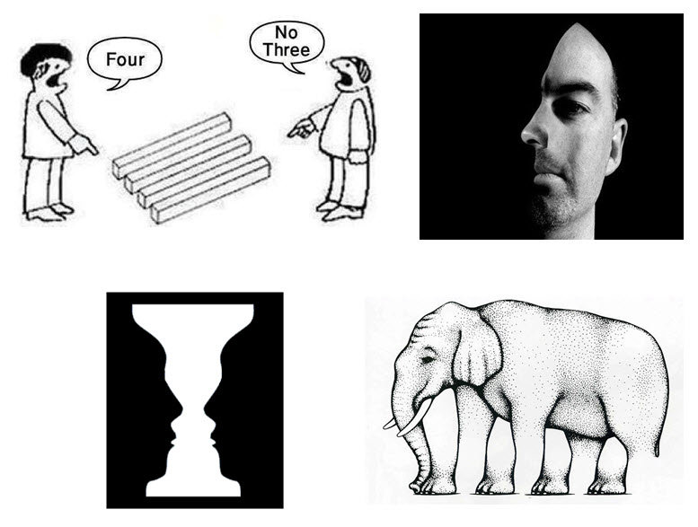
Explain in words….
HOW and WHY?
or
WHY NOT?

Slide 124
Consideration of Allegations
(cont'd)
ELO
15
1
Example of a Poor Analysis Paragraph (5) :
Multiple credible witnesses believed that COL Brown was having an affair with Ms. Smith. Ms. Smith had sexual intercourse with COL Brown on multiple occasions. Evidence demonstrated that COL Brown met with Ms. Smith at the Notel Motel, where COL Brown registered as a couple when his wife was out of town. COL Brown denied the allegation; however, it appears that COL Brown is guilty of wrongfully engaging in extramarital sexual conduct. The preponderance of credible evidence indicated the allegation is founded.
What is wrong with this paragraph?
What is missing?
What are the elements of proof?
        The A&I Guide, Part Two, Section 4-13 (II-4-44 to 150) , Appendix D
Notes:
124

Slide 125
Consideration of Allegations
(cont'd)
ELO
15
1
EXAMPLE OF A BETTER ANALYSIS PARAGRAPH (5) :
Analyzes the evidence (credible vs. not credible)
Addresses both sides of the evidence (witness statements vs. COL Brown)
Demonstrates how the evidence meets or fails to meet the elements of proof:
    Incident of sexual intercourse
    One or both were married
    Conduct was prejudicial to good order and discipline
See A&I Guide, page II-4-64
        The A&I Guide, Part Two, Section 4-13 (II-4-44 to 150) , Appendix D
Notes:
125

Slide 126
Consideration of Allegations
(cont'd)- USE THIS FOR YOUR HOMEWORK
ELO
15
1
c. CONCLUSION: {one concise sentence} The allegation that (name) improperly (unless wrongdoing is clearly inherent in the language) (did or failed to do something) in violation of (standard) was Substantiated or was Not Substantiated.
        The A&I Guide, Part Two, Section 4-13 (II-4-44 to 150) , Appendix D

Slide 127
Next Allegation(s), Other Matters, Recommendation(s)
ELO
15
2
2. (NOT SUBSTANTIATED) ALLEGATION: COL Brown was
improperly absent from his place of duty in violation of ...
a. Evidence ... b. Discussion ... c. Conclusion ...
OTHER MATTERS:
3. Issue the commander must address
4. Issue awareness for the commander
{do not introduce 'new' evidence or issues}
3
must lead to
RECOMMENDATIONS:
5. Approve the report and close the case
6. Address each OTHER MATTER with a recommendation
7. Address each OTHER MATTER with a recommendation
4
(Always first!)
IGs never recommend adverse action. However, recommending administrative action to correct a mistake is appropriate. For instance, recovering an unauthorized BAH or TDY payment is not an adverse action.
        The A&I Guide, Part Two, Section 4-13( II-4-44 to 150) , Appendix D

Slide 128
Synopsis
Write this part LAST!
ELO
15
USE THIS FOR YOUR HOMEWORK
The SYNOPSIS should include a concise summary of all parts of the Consideration of the Allegations section to include: the allegation, the elements of proof from the standard, the key evidence on BOTH SIDES, and a comparison of the evidence (your analysis) leading to the conclusion that the allegation was/was not substantiated.
Conclude the synopsis with a finding statement that states:
“The preponderance of credible evidence indicated that (name) (improperly – unless wrongdoing is clearly inherent in the language) (did) or (failed to do) (something).”
Your SYNOPSIS Should Not:
Introduce new information or information not discussed / presented in the Consideration of Allegations section
Include all of the details available in the ROI
5
        The A&I Guide, Part Two, Section 4-13 ( II-4-44 to 150) , Appendix D

Slide 129
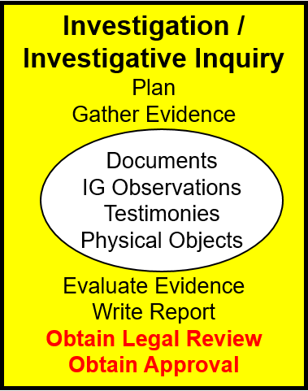
Step Four:
IG Fact Finding
SJA reviews
Always for ROI
'S' for ROII
Hand-carry the report
CIG usually briefs results
Commander can:
  Approve
  Modify
  Direct additional action
  Disapprove
AR 20-1, Paragraph 7-1b(4); The A&I Guide, Part Two, Section 4-15 (II-4-152)

Slide 130
Step Five:
Final Notifications
Step 5 Make Notification of Results
AR 20-1, paragraph 7-1b(5) The A&I Guide, Part Two, Chapter 5 (II-5-1)

Slide 131
Make Notification of Results
(Step 5)
The IG prepares all IG records for proper retention before notifications
Commander / Supervisor: [Format: A&I Guide page II-5-4]
  Notify them in writing of the approved results in the ROI / ROII and enclose a copy of the notification in the case file
Subject / Suspect: [Format: A&I Guide page II-5-3]
  Notify them in writing of the approved results of the ROI / ROII and enclose a copy of the notification in the case file
  Notify them of any unfavorable information included in the ROI / ROII if they were not previously apprised during the investigation, and provide them the opportunity to comment
  Notification of any substantiated allegations must include FOIA request procedures / instructions
AR 20-1, Paragraph 7-1b(5); The A&I Guide, Part Two, Chapter 5 (II-5-3)

Slide 132
Step Six:
Follow-Up
Step 6 Follow-Up
Ensure that all IG allegations and issues were thoroughly addressed and IG responsibilities were completed.
The IG will attach to the electronic IGARS file all notifications and responses received from the subject or suspect relating to unfavorable information that appeared in the ROI / ROII.
AR 20-1, Paragraph 6-1 & 7-1
The A&I Guide, Part Two, Chapter 6 (II-6-1)

Slide 133
Step Seven:
Close the IGAR
Step 7 Close the IGAR
Provide complainant a final reply in writing [Format: A&I Guide page II-7-2]
Close the file in the IGARS database
Make appropriate reports
Analyze developing trends
AR 20-1, Paragraph 7-1
The A&I Guide, Part Two, Chapter 7 (II-7-1)

Slide 134
Summary
ELO 15. Complete a Report of Investigation (ROI).
  ROI utilization
  Order ROI is written (first, last, and why?)
  Interview order
  Required information to subject / suspect in substantiated finding

Slide 135

QUESTIONS?

